Slide 1
UNIT - III
MEDIUM ACCESS CONTROL SUB LAYER

Slide 2
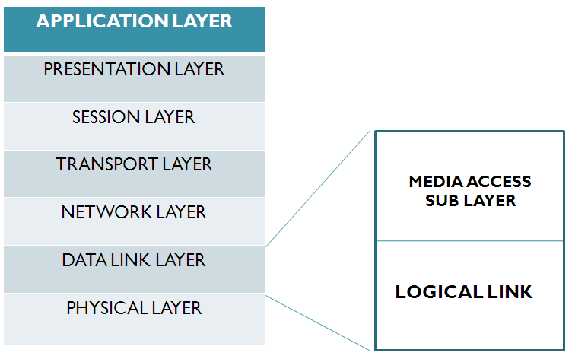
MEDIUM ACCESS CONTROL SUB LAYER

Slide 3
MEDIUM ACCESS CONTROL
A network of computers based on multi-access medium requires a protocol for effective sharing of the media.
If there is a dedicated link between the sender and the receiver then data link control layer is sufficient, however if there is no dedicated link present then multiple stations can access the channel simultaneously. Hence multiple access protocols are required to decrease collision and avoid crosstalk
As only one node can send or transmit signal at a time using the broadcast mode, the main problem here is how different nodes get control of the medium to send data
The protocols used for this purpose are known as Medium Access Control (MAC) techniques

Slide 4
MAC cntd..
The key issues involved here are
Whether the control is exercised in a centralized or distributed manner
In what manner the control is exercised. It is constrained by the topology and trade off between cost-performance and complexity

Slide 5
MAC cntd….
A centralized scheme has a number of advantages as mentioned below:
Greater control to provide features like priority, overrides, and guaranteed bandwidth.
Simpler logic at each node.
Easy coordination.
In a distributed approach all the nodes collectively perform a medium access control function and dynamically decide which node to be granted access.
This approach is more reliable than the Centralized

Slide 6
GOALS OF MAC TECHNIQUES
Initialization: The technique enables network stations, upon power-up, to enter the state required for operation.
Fairness: The technique should treat each station fairly in terms of the time it is made to wait until it gains entry to the network, access time and the time it is allowed to spend for transmission.
Priority: In managing access and communications time, the technique should be able to give priority to some stations over other stations to facilitate different type of services needed.
Limitations to one station: The techniques should allow transmission by one station at a time.

Slide 7
GOALS OF MAC TECHNIQUES
Receipt: The technique should ensure that message packets are actually received (no lost packets) and delivered only once (no duplicate packets), and are received in the proper order.
Error Limitation: The method should be capable of encompassing an appropriate error detection scheme.
Recovery: If two packets collide (are present on the network at the same time), or if notice of a collision appears, the method should be able to recover, i.e. be able to halt all the transmissions and select one station to retransmit.

Slide 8
GOALS OF MAC TECHNIQUES
Reconfigurability: The technique should enable a network to accommodate the addition or deletion of a station with no more than a noise transient from which the network station can recover.
Compatibility: The technique should accommodate equipment from all vendors who build to its specification.
Reliability: The technique should enable a network to confine operating inspite of a failure of one or several stations.

Slide 9
CHANNEL ALLOCATION PROBLEM
How to allocate a single broadcast channel among competing users. The channel might be a portion of the wireless spectrum in a geographic region, or a single wire or optical fiber to which multiple nodes are connected.

Slide 10
CHANNEL ALLOCATION PROBLEM
STATIC CHANNEL ALLOCATION IN LANs AND MANs
FDM is used to allocate channel for a single user over a multiple competing users
With FDM, when there are N users, the Bandwidth is divided into N equal portions and each user is allocated one portion
Problems
Allocations are static therefore the channels allocated for a user cannot be allocated for others even when the channel is idle
As the no of users increases and varying it becomes difficult to maintain

Slide 11

CHANNEL ALLOCATION PROBLEM
STATIC CHANNEL ALLOCATION IN LANs AND MANs
Assume
Time delay for an user T
channel of capacity C bps
arrival rate of λ frames/sec,
each frame having a length drawn from an exponential probability density function with mean 1/μ bits/frame.
With these parameters the arrival rate is λ frames/sec and the service rate is μC frames/sec.
From queueing theory it can be shown that for Poisson arrival and service times
11

Slide 12

CHANNEL ALLOCATION PROBLEM
STATIC CHANNEL ALLOCATION IN LANs AND MANs
Now let us divide the single sub channel into N independent sub channels, each with capacity C/ N bps.
The mean input rate on each of the sub channels will be λ/N
In this case, T is given by
Therefore, the Mean Time Delay using FDM is N times worse than if all the frames were arranged orderly in a queue

Slide 13
CHANNEL ALLOCATION PROBLEM
DYNAMIC CHANNEL ALLOCATION IN LANs AND MANs
The Dynamic channel allocation is made based on five assumptions
Station Model
Single Channel Assumption
Collision Assumption
a. Continuous time
b. Slotted Time
a. Carrier Sense
b. No Carrier Sense
13

Slide 14
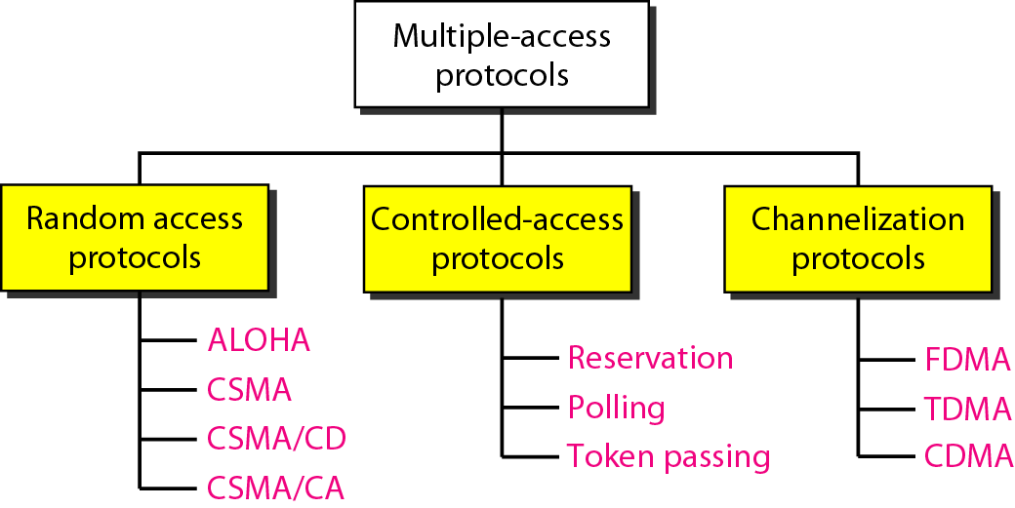
MAC CATEGORIES

Slide 15
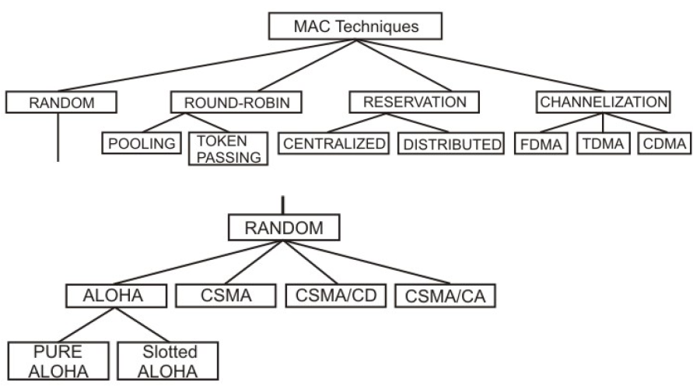
MAC CATEGORIES

Slide 16
Random Access Protocol
All stations have same superiority that is no station has more priority than another station. Any station can send data depending on the medium’s state( idle or busy). It has two features:
There is no fixed time for sending data
There is no fixed sequence of stations sending data

Slide 17
RANDOM ACESS PROTOCOLS
ALOHA
PURE ALOHA
SLOTTED ALOHA
Carrier Sense Multiple Access Protocols
Collision-Free Protocols

Slide 18
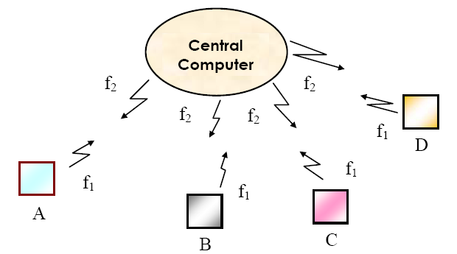
MAC PROTOCOLS - ALOHA
The ALOHA scheme was invented by Abramson in 1970 for a packet radio network
connecting remote stations to a central computer and various data terminals

Slide 19
MAC PROTOCOLS - ALOHA
Users are allowed random access of the central computer through a common radio frequency band f1 and the computer centre broadcasts all received signals on a different frequency band f2. This enables the users to monitor packet collisions, if any.
The protocol followed by the users is simplest; whenever a node has a packet to sent, it simply does so. This scheme is known as Pure ALOHA
Frames will suffer collision and colliding frames will be destroyed. By monitoring the signal sent by the central computer, after the maximum round-trip propagation time, an user comes to know whether the packet sent by it has suffered a collision or not.

Slide 20
PURE ALOHA

Slide 21
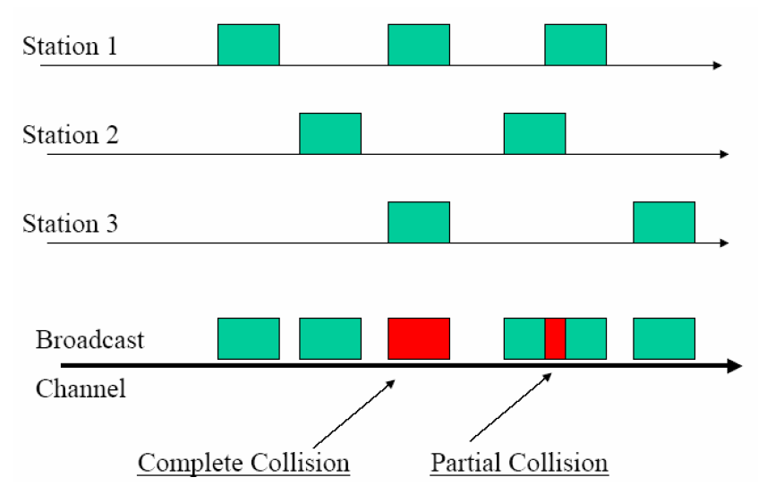
PURE ALOHA

Slide 22
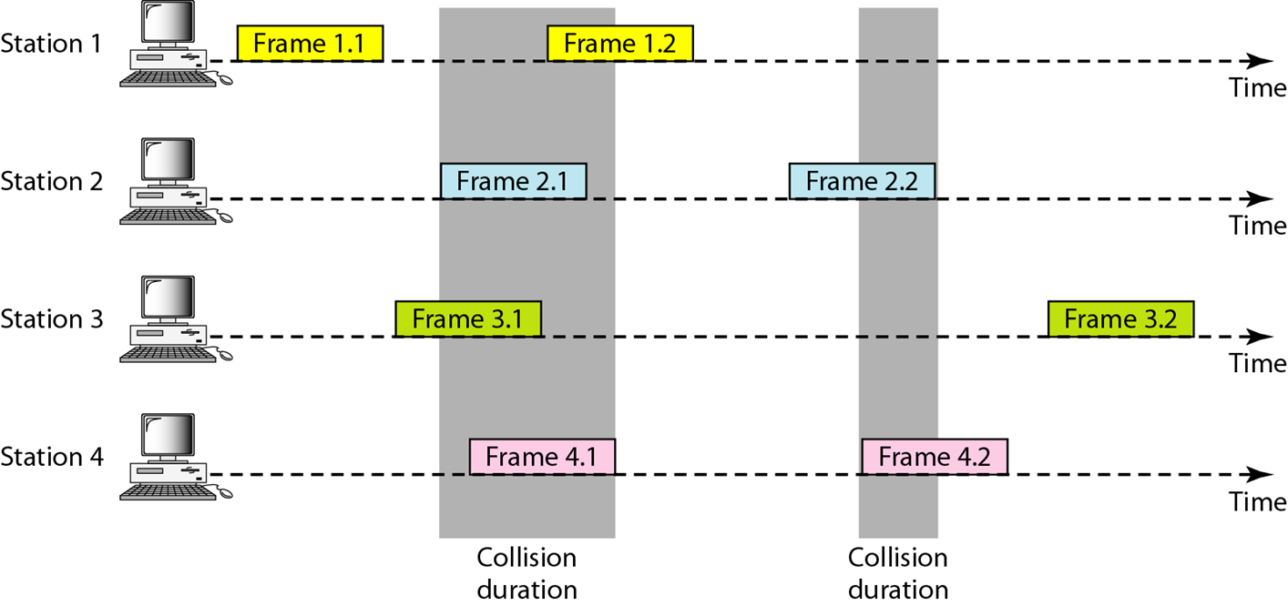
PURE ALOHA

Slide 23
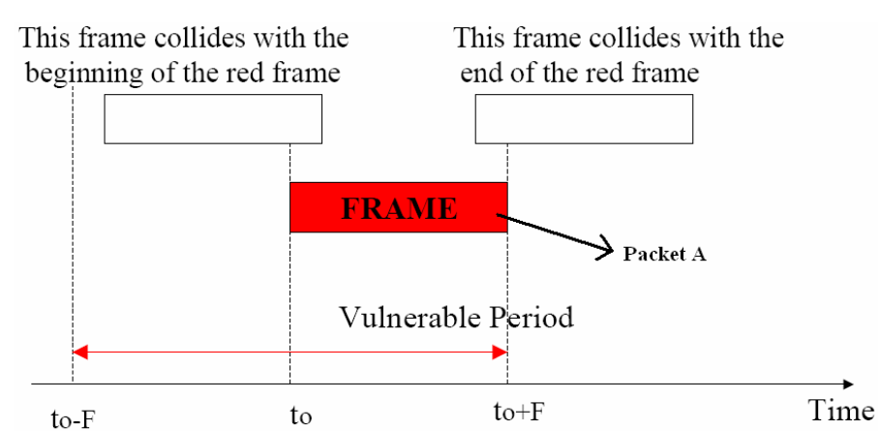
PURE ALOHA

Slide 24
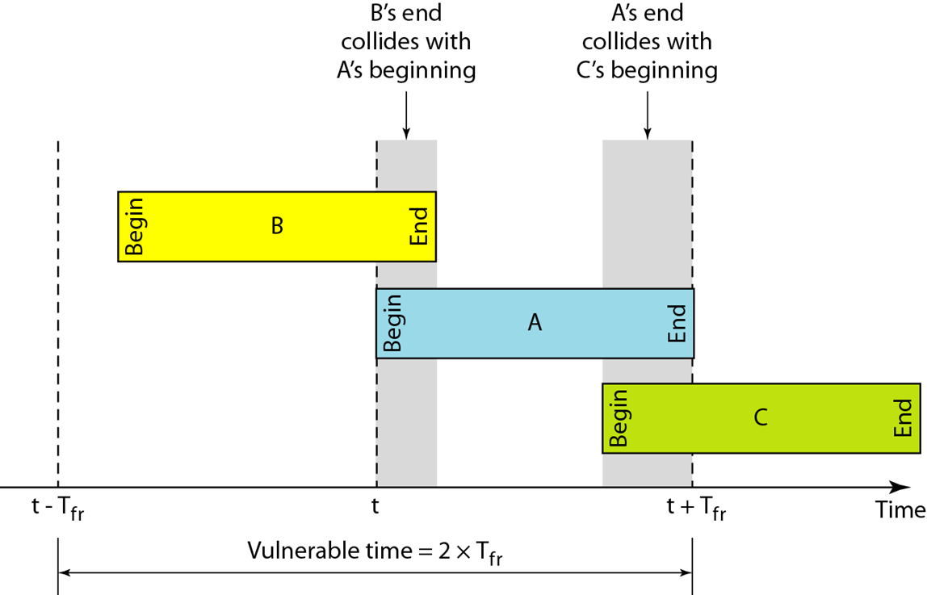

Slide 25
MAC PROTOCOLS – ALOHA (PURE)
If all packets have a fixed duration of F then a given packet A will suffer collision if another user starts to transmit at any time from F before to until F after the start of the packet A
This gives a vulnerable period of 2F. Based on this assumption, the channel utilization can be computed. The channel utilization, expressed as throughput S, in terms of the offered load G is given by
S=G e^{-2G}
The best channel utilization of 18% can be obtained at 50 percent of the offered load

Slide 26
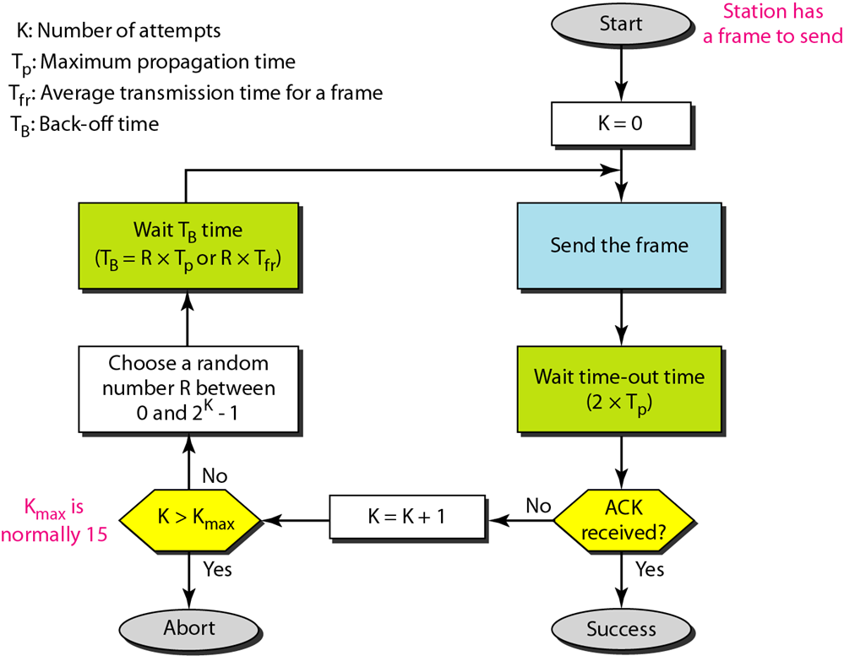
Procedure for pure ALOHA protocol

Slide 27
MAC PROTOCOLS – ALOHA (SLOT TED)
To improve upon the efficiency of pure ALOHA, a new scheme known as Slotted ALOHA is introduced
In this scheme, the channel is divided into slots equal to F and packet transmission can start only at the beginning of a slot
This reduces the vulnerable period from 2τ to τ and improves efficiency by reducing the probability of collision
This gives a maximum throughput of 37% at 100 percent of the offered load

Slide 28
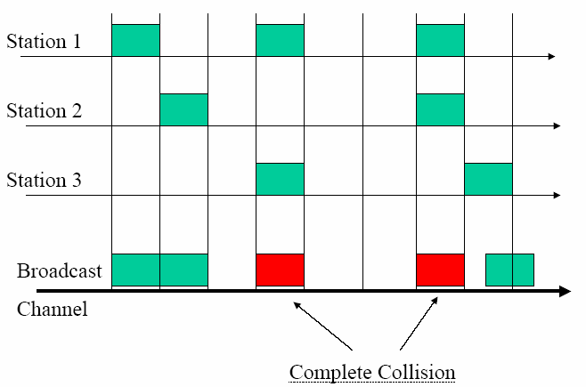
MAC PROTOCOLS – ALOHA (SLOT TED)

Slide 29
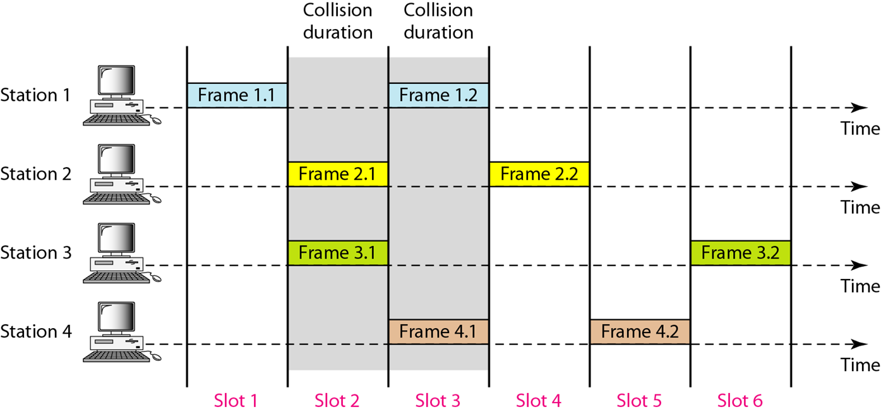
Frames in a slotted ALOHA network

Slide 30
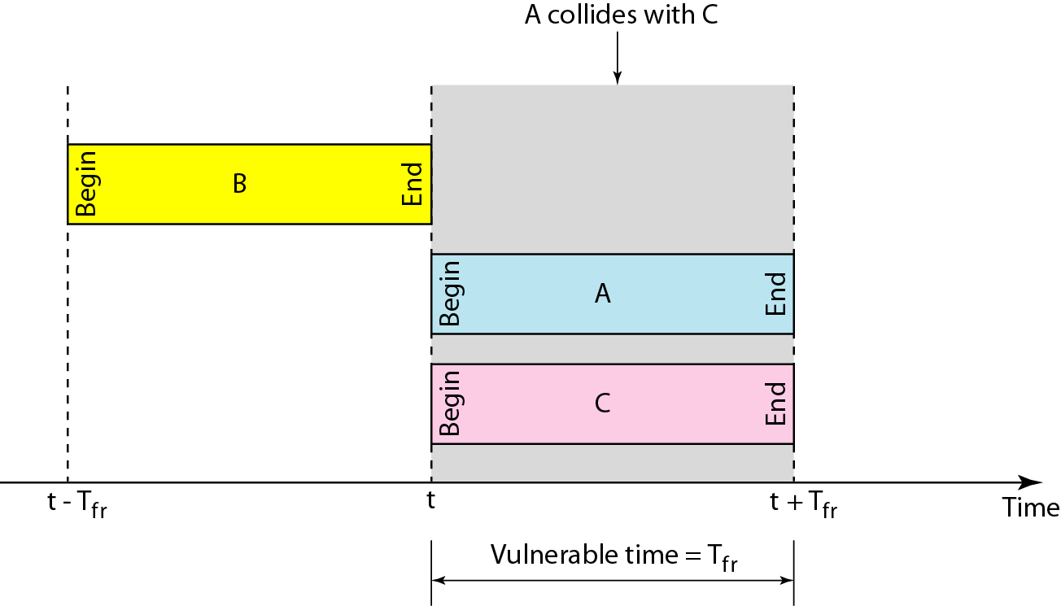

Slide 31
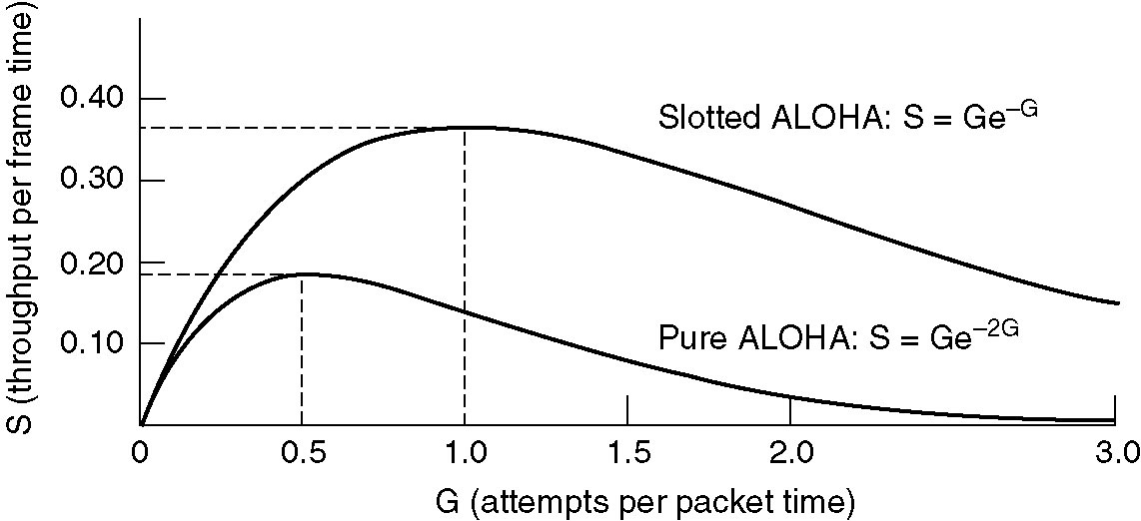
MAC PROTOCOLS – ALOHA (PURE vs SLOTTED)

Slide 32
MAC PROTOCOLS – CSMA
The poor efficiency of the ALOHA scheme is due to the fact that a node start transmission without paying any attention to what others are doing.
In situations where propagation delay of the signal between two nodes is small compared to the transmission time of a packet, all other nodes will know very quickly when a node starts transmission.
Protocols in which stations listen for a carrier (i.e., a transmission) and act accordingly are called carrier sense protocols.
In CSMA, a node having data to transmit first listens to the medium to check whether another transmission is in progress or not.
The node starts sending only when the channel is free, that is there is no carrier. That is why the scheme is also known as listen-before talk.

Slide 33
MAC PROTOCOLS – CSMA
There are three variations of CSMA
1-persistent CSMA: In this case, a node having data to send, start sending, if the channel is sensed free. If the medium is busy, the node continues to monitor until the channel is idle. Then it starts sending data. The protocol is called 1-persistent because the station transmits with a probability of 1 when it finds the channel idle
Non-persistent CSMA: If the channel is sensed free, the node starts sending the packet. Otherwise, the node waits for a random amount of time and then monitors the channel
p-persistent CSMA: If the channel is free, a node starts sending the packet. Otherwise the node continues to monitor until the channel is free and then it sends with probability p

Slide 34
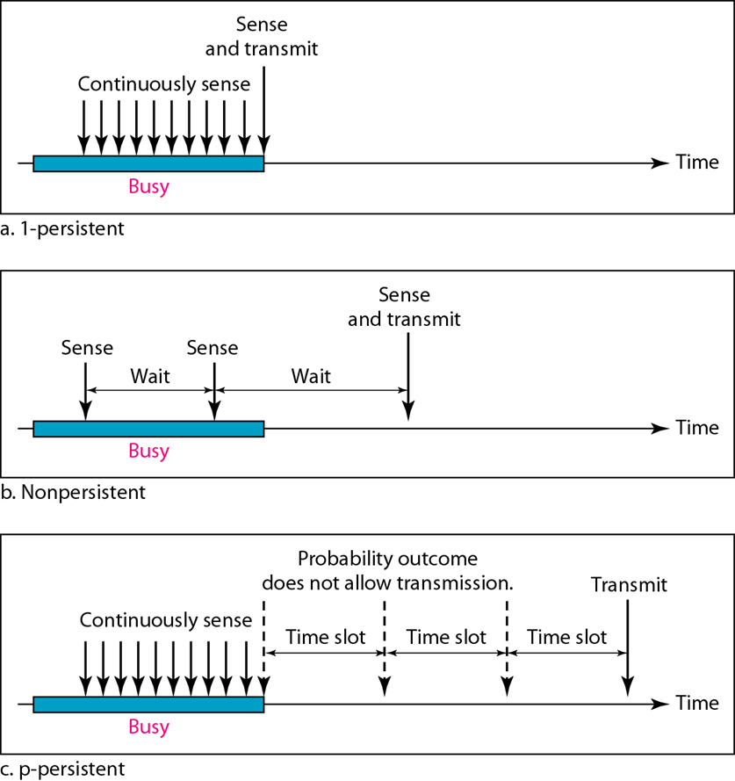

Slide 35

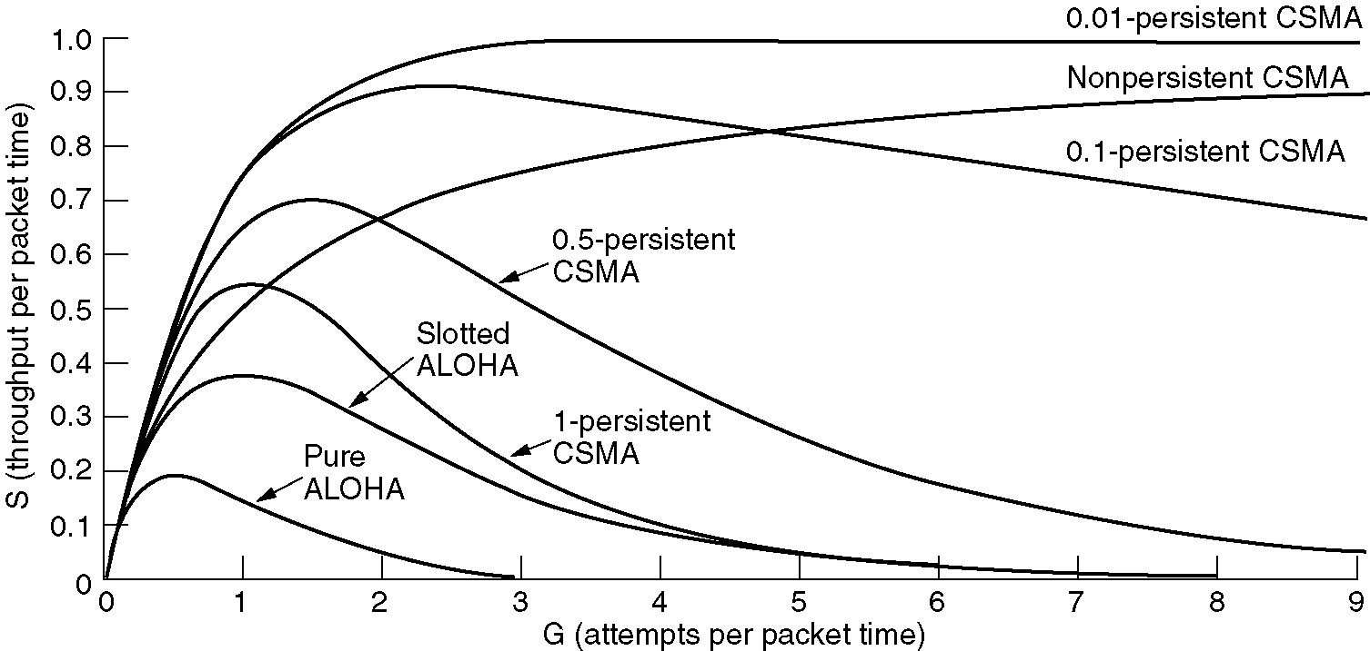
MAC PROTOCOLS – CSMA
The efficiency of CSMA scheme depends on the propagation delay, which is represented by parameter a, as defined below:

Slide 36
MAC PROTOCOLS – CSMA/CD
Persistent and non-persistent CSMA protocols are clearly an improvement over ALOHA because they ensure that no station begins to transmit when it senses the channel busy.
Another improvement is for stations to abort their transmissions as soon as they detect a collision
This protocol is widely used on LANs in the MAC sublayer and is known as known as CSMA/CD (CSMA with Collision Detection)

Slide 37
MAC PROTOCOLS – CSMA/CD
On top of the CSMA, the following rules are added to convert it into CSMA/CD:
If a collision is detected during transmission of a packet, the node immediately ceases transmission and it transmits jamming signal for a brief duration to ensure that all stations know that collision has occurred.
2. After transmitting the jamming signal, the node waits for a random amount of time and then transmission is resumed.
The random delay ensures that the nodes, which were involved in the collision are not likely to have a collision at the time of retransmissions. To achieve stability in the back off scheme, a technique known as binary exponential back off is used.

Slide 38
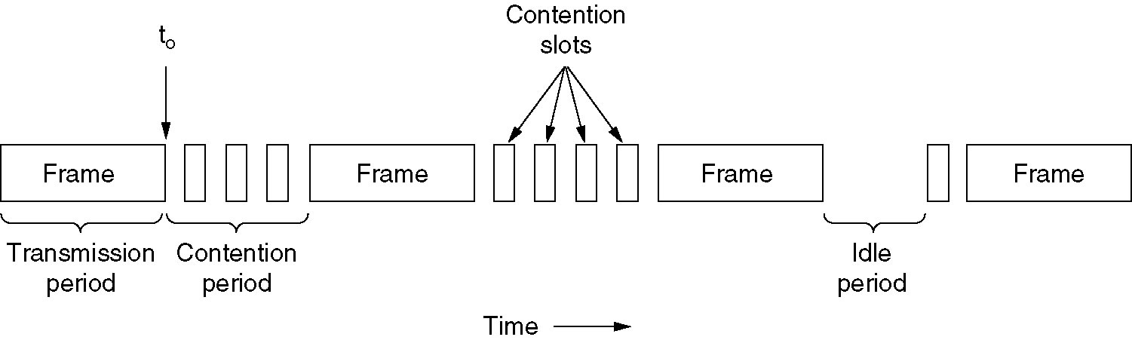
CSMA/CD
CSMA/CD uses the conceptual model shown in figure below
At the point marked t₀, a station has finished transmitting its frame. Any other station having a frame to send may now attempt to do so.
If two or more stations decide to transmit simultaneously, there will be a collision.

Slide 39
MAC PROTOCOLS – CSMA/CD
Collisions can be detected by looking at the power or pulse width of the received signal and comparing it to the transmitted signal
After a station detects a collision, it aborts its transmission, waits a random period of time, and then tries again, assuming that no other station has started transmitting in the meantime.
Therefore, our model for CSMA/CD will consist of alternating contention and transmission periods, with idle periods occurring when all stations are quiet

